Slide 1
Digital Portfolio
Aravindhan G
STUDENT NAME:
REGISTER NO AND NMID:
DEPARTMENT:
COLLEGE: THIRUVALLUVAR UNIVERSITY
astvu30030024u18005
BSC Computer science

Slide 2
PROJECT TITLE
Digital Portfolio Using HTML, CSS, Java Script

Slide 3


AGENDA
Problem Statement
Project Overview
End Users
Tools and Technologies
Portfolio design and Layout
Features and Functionality
Results and Screenshots
Conclusion
Github Link
3/21/2024 Annual Review

Slide 4

PROBLEM STATEMENT
In the modern digital era, individuals need an effective way to showcase their skills, achievements, and projects beyond traditional resumes. Static resumes fail to highlight creativity and real-time updates. A digital portfolio solves this problem by providing a professional, interactive, and accessible platform to represent personal and professional information.

Slide 5

PROJECT OVERVIEW
The project "Digital Portfolio" is a web-based personal profile website designed using HTML for structure, CSS for styling, and JavaScript for interactivity. The portfolio provides an organized representation of personal details, educational background, skills, projects, and contact information. It helps individuals build their online presence and make a strong impression in academic, professional, and career opportunities.

Slide 6

WHO ARE THE END USERS?
Students & Fresh Graduates: To showcase skills, projects, and resumes.
Professionals & Job Seekers: To highlight work experience and achievements.
Freelancers & Creatives: To display project portfolios and attract clients.
Employers/Recruiters: To quickly evaluate a candidate's skills and experience.

Slide 7
TOOLS AND TECHNIQUES
HTML5: For creating the structure of web pages.
CSS3: For styling, responsive design, and layout.
JavaScript: For interactivity (form validation, animations, dark/light mode).
Text Editor/IDE: VS Code, Sublime Text, or Notepad++.
Browser: Google Chrome, Firefox, or Edge for testing.
(Optional) GitHub Pages/Netlify: For hosting the portfolio online.

Slide 8
POTFOLIO DESIGN AND LAYOUT
Header & Navigation Bar - Fixed navigation for smooth scrolling between sections.
Home Section - Personal introduction, profile picture, tagline.
About Section Bio, education, and skill summary.
Projects Section - Showcasing academic and personal projects with descriptions.
Resume/Skills Section - Downloadable
resume and skill progress indicators.
Contact Section Contact form, email, and
social media links.
Footer - Copyright and quick links.
Design Elements:
Minimal and professional theme (light/dark mode option).
Grid/Flexbox layout for responsiveness.
Hover effects and animations for interactivity.
8

Slide 9
FEATURES AND FUNCTIONALITY
Interactive Navigation: Smooth scrolling between sections.
Responsive Design: Works on mobile, tablet, and desktop.
Contact Form: Simple message submission with JavaScript validation.
Download Resume: Option to download CV directly.
Dark/Light Mode Toggle: Switch theme for better user experience.
Project Gallery: Show projects with images and links.
Animations/Transitions: CSS and JS-based interactive effects.

Slide 10
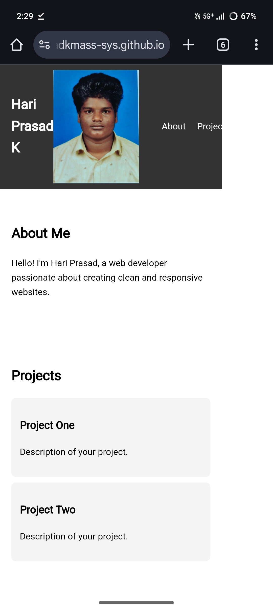

RESULTS AND SCREENSHOTS
3/21/2024 Annual Review
10

Slide 11
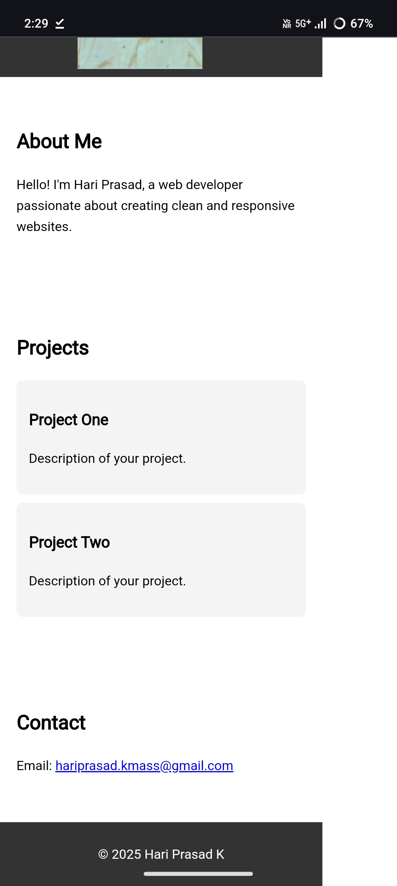
Result and scrrenshot

Slide 12
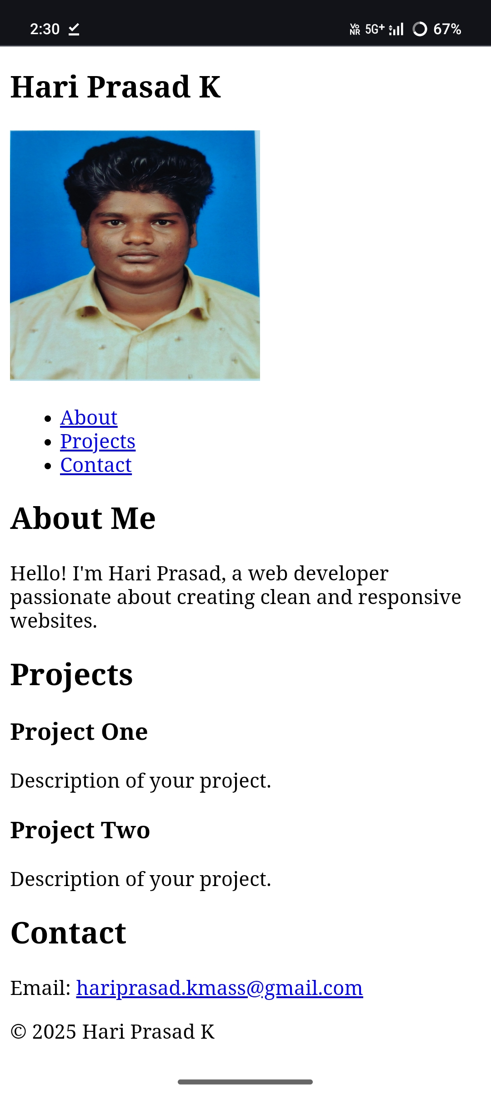
Result and scrrenshot:

Slide 13
CONCLUSION
The Digital Portfolio Project demonstrates how web technologies can be used to create a professional, responsive, and interactive personal profile website. It provides a modern solution for individuals to showcase their identity, skills, and achievements effectively. The project is simple yet impactful, scalable, and can be continuously updated, making it an essential tool for career development in the digital age.
13

